Slide 1
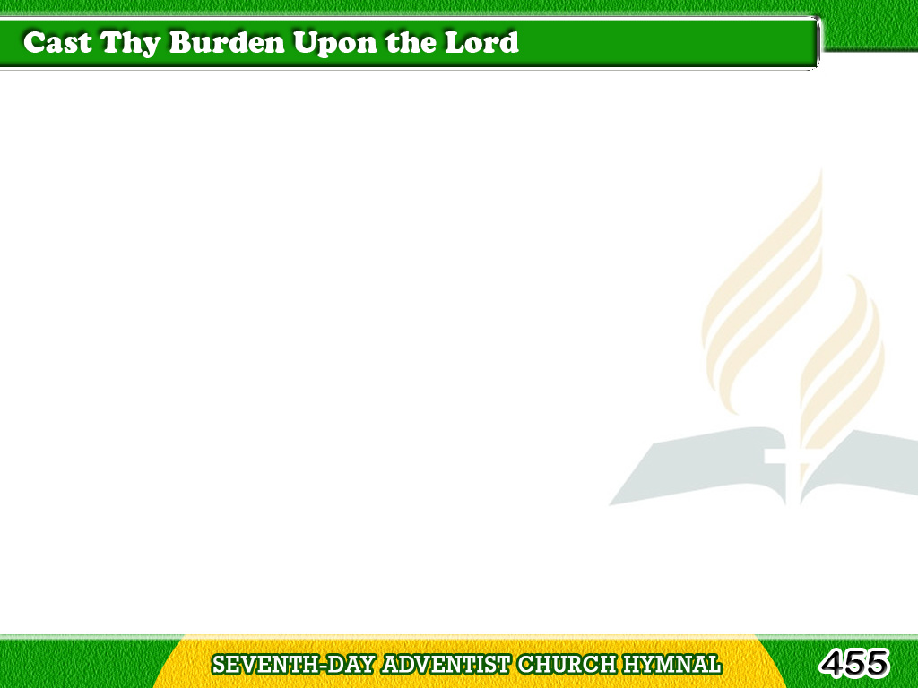
1/1
Cast thy burden upon the Lord,
And He shall sustain thee;
He never will suffer
the righteous to fall;
He is at thy right hand.
Tagalog
Version

Slide 2
1/1
Thy mercy, Lord, is great,
and far above the heavens;
Let none made ashamed,
that wait upon Thee.
Tagalog
Version

